Slide 1



Fusion HCM Reporting Tool - OTBI

Slide 2

Agenda
Introduction
Getting Started (Demo)
Cross Subject Area Reports
Accessing Flex fields
Documentation
Q & A

Slide 3
Introduction

Slide 4
OTBI
Introduction
Real time self-service reporting tool in Fusion HCM application.
It is an easy to use tool designed to create quick reports.
Collect up-to-date data from your organization.
Present the data in easy-to-understand formats like tables and graphs.
It consists Pre-defined Subject Areas Provided by Oracle

Slide 5
OTBI
Subject Area Features
OTBI subject areas is used to create or edit analysis reports
Subject areas are pre built meta-data content for BI reporting solutions
Subject areas are made up of logical data structures combined together and each of them are associated with specific application modules
OTBI organizes reporting data elements like Dimensions and Facts by business function in Subject Areas.
OTBI inherits Fusion user roles and security profiles.

Slide 6
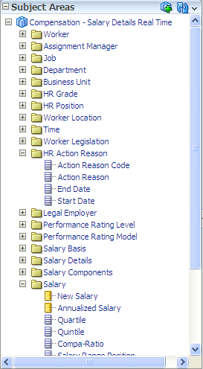
OTBI
Subject Area, Presentation Folders, Attributes, and Measures
Subject Area is a collection of functional reporting metadata organized by folders and columns for ad-hoc reporting.
Subject Area
Dimension - Presentation Folders
Dimension - Attributes
Fact – Presentation Folder
Fact – Measures

Slide 7
Subject Area, Presentation Folders, Attributes, and Measures
Subject Area | All the related functions are grouped under a specific subject area. For example: The Salary Details of employees are grouped under the subject area called “Compensation – Salary Details”. Worker assignment changes are grouped under the subject area called “Workforce Management - Worker Assignment Event Real Time”

Slide 8
Subject Area, Presentation Folders, Attributes, and Measures
Dimension Presentation Folder | Dimension Presentation Folders – Each of the Subject Areas contain multiple folders within them. Related information are grouped under the presentation folders. For ex: Employee information like Person name, DOB, marital status, ethnicity can be grouped under ‘Worker’ folder. Similarly, current salary, previous salary etc. can be grouped under the ‘Salary’ folder
Attributes | The information like ‘Person Name’, ‘dob, ‘Region’, etc are the various attributes. These attributes are grouped under the dimension presentation folder. Attributes mostly refer to “text” or “date” values

Slide 9
Subject Area, Presentation Folders, Attributes, and Measures
Fact Presentation Folders | The Fact Presentation Folders contain the information about the metrics for the various dimension attributes. For ex: current salary, prior salary can be grouped under the ‘Salary’ folder
Measures | Measures are mostly numeric attributes. For example, “Current Salary”, “Prior Salary”, “# Of Hires”, “# Of Promotions” etc. These measures are grouped under the fact presentation folder

Slide 10
OTBI Scope Summary
Benefits
Action Items Enrollment Opportunities Enrollments Potential Life Events Setup
Compensation
Salary Details Stock Details
Payroll
Payments Costing Payments Distribution Payroll Run Costing Payroll Run Results Retroactive Pay
Workforce Goals
Goal Alignments Goal Status Overview Goal Tasks Target Outcomes
Workforce Performance
Performance Document Status Performance Rating Distribution Performance Rating Performance Task Status
Workforce Profiles
Library Objects Model Profile Person Profile
Workforce Management
Absence Employment Contract Grade Rate Person Position Work Relationship Worker Assignment Event Worker Assignment

Slide 11
Real-Time Analysis – Workforce Management
  Path for Seeded OTBI Reports:
  Workforce Information Reports:
  /Shared Folders/Human Capital Management/Workforce Management/Transactional Analysis Samples/Grade Details
  Compensation Reports:
  /Shared Folders/Human Capital Management/Compensation/Transactional Analysis Samples/

Slide 12
Getting Started

Slide 13
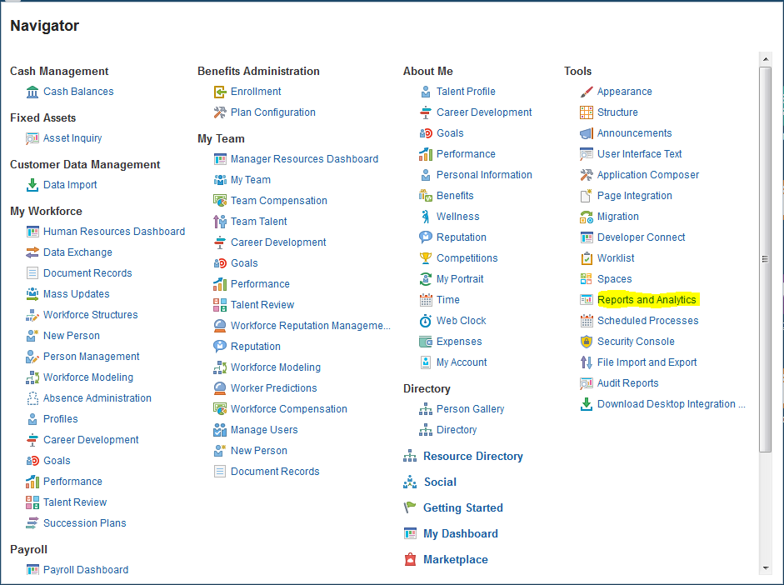
Creating OTBI Reports
  Navigation: For accessing the Analytics page
  Login to Fusion Application → Navigator → Tools → Reports and Analytics Link

Slide 14
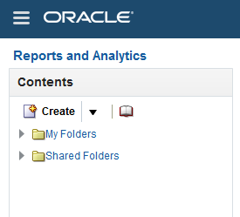
Creating OTBI Reports
Navigation: Login to fusion application > Tools > Reports and Analytics > Browse catalog
Access BI Composer
Access BI Answers
Access Web Catalog

Slide 15
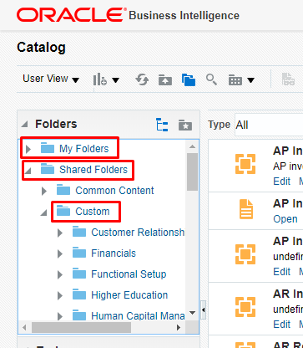
Fusion Reporting (cont.)
Folder Structure:
My Folders – User specific folder for draft development.
Shared Folders –Can be accessed by all the users and contains both standard and custom report
Custom – Contains both custom and customized standard reports.

Slide 16
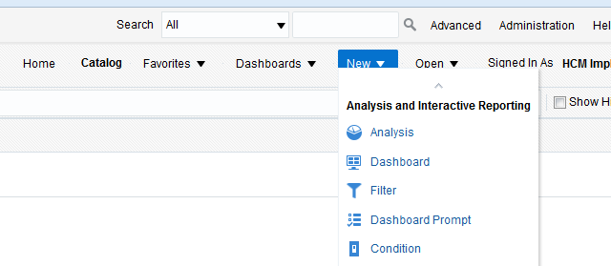
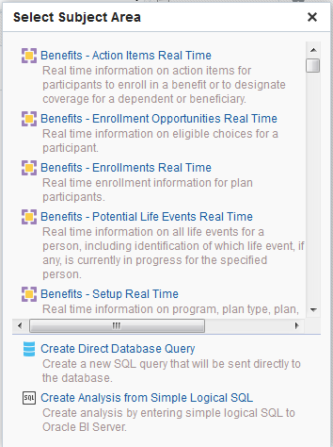
Creating OTBI Reports
Create Report in BI Answers

Slide 17
Creating Analysis
Perform the following steps to build an analysis using Analysis editor.
Create the analysis.
Specify the criteria for the analysis.
Display the results of the analysis.
Add prompts to the analysis.
Save the analysis.

Slide 18
Creating Analysis (Cont.)
The Analysis editor is technically advanced and contains the following tabs:
Criteria Tab — By using the Criteria Tab you build up a report. It lets you specify the criteria for an analysis, including columns and filters. You can specify the order in which the results should be returned, formatting (such as headings, number of decimal places, styles such as fonts and colors, and conditional formatting), and column formulas (such as adding a Rank or Percentile function).
Results Tab —The Results tab is where you can view the results of the OTBA report based on the columns that were extracted onto the Criteria tab. It lets you create different views of the analysis results such as graphs, tickers, and pivot tables. You can also add or modify selection steps.
Prompts Tab — The prompts tab is where you can build various kinds of prompts. This tab lets you create prompts that allow users to select values to filter an analysis or analyses on a dashboard. Prompts allow users to select values that dynamically filter all views within the analysis or analyses.
Advanced Tab — this tab lets you edit XML code and examine the logical SQL statement that was generated for an analysis. You can use the existing SQL statement as the basis for creating a new analysis. Additional filters for the report can be added in the Advanced Tab. Using this tab, you can generate XML and save into the system. This particular XML can be used as a data source in BI Publisher Report and create complex report and further customization can be done in BI Publisher Report.

Slide 19
Build of Custom OTBI Report
Steps to create a new Analysis report:
Choose the Subject Area
Drag and Drop/Double click the required columns to appear on the ‘Selected Columns’ workspace
Add criterias, prompts etc
Insert the views in result tab ( table, pivot tabl, graph, chart etc)

Slide 20
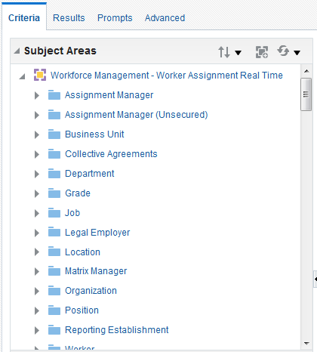
Creating OTBI Reports
Choose the Subject Area. The selected subject area will appear in the left pane.

Slide 21
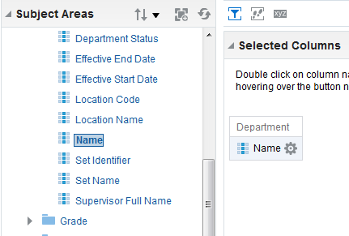

Creating OTBI Reports
Drag and Drop/Double click the required columns to appear on the ‘Selected Columns’ workspace
You can select multiple non-contiguous columns by using the Ctrl key, selecting each column to include, and then dragging the columns to the Selected Columns pane.

Slide 22
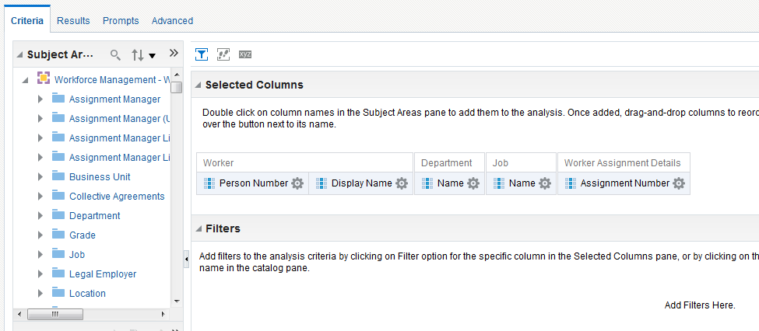
Build of Custom OTBI Report
Subject Area: Workforce Management - Worker Assignment Real Time

Slide 23
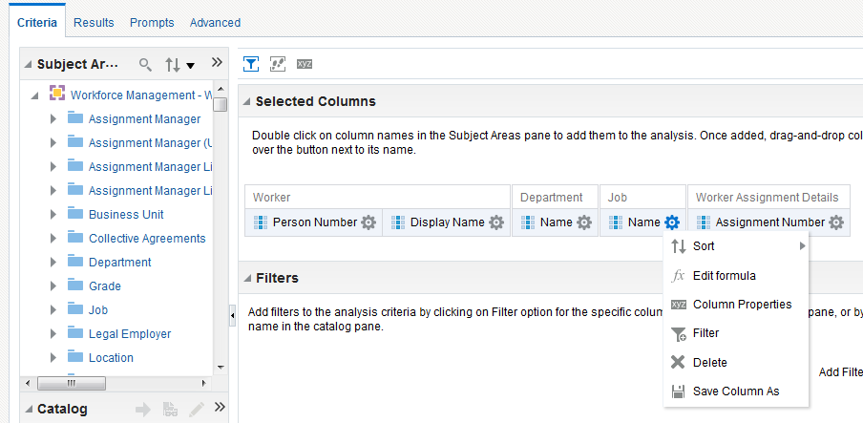
Build of Custom OTBI Report
Change the column label in the “Column Properties”

Slide 24
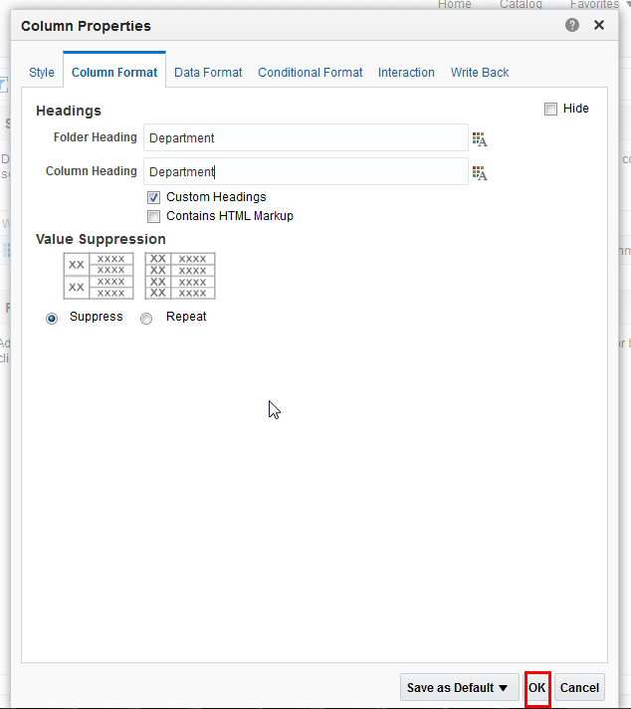
Build of Custom OTBI Report

Slide 25
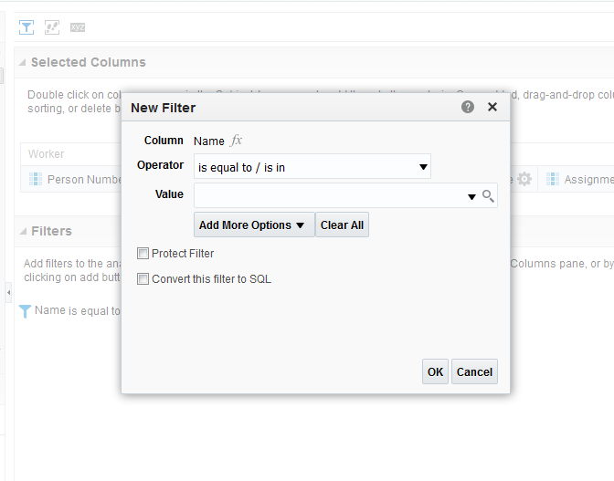
Build of Custom OTBI Report
Apply the filter on the “Department” column

Slide 26
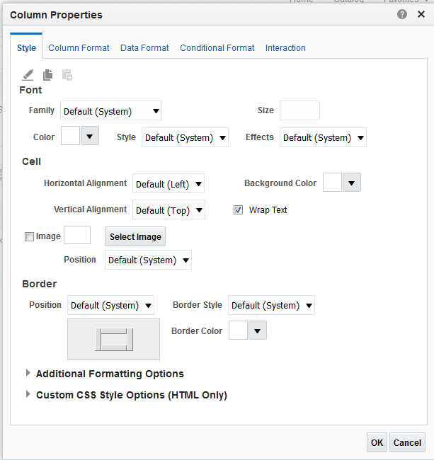
Creating OTBI Reports
You can edit column properties to control the look and feel of the column. For example, you can specify that values in the Revenue column are displayed with two decimal places and a dollar sign.

Slide 27
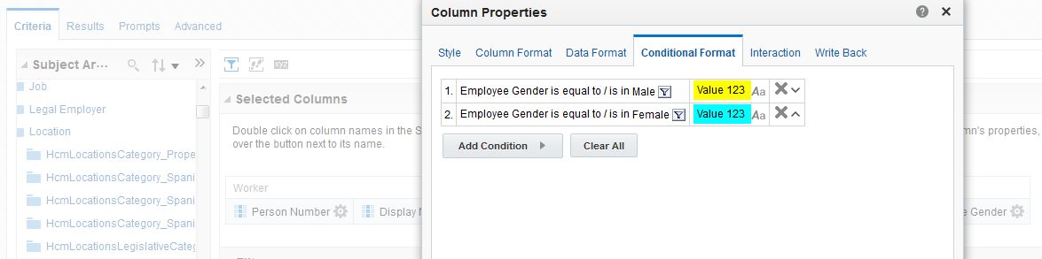
Build of Custom OTBI Report
Conditional Formatting:

Slide 28
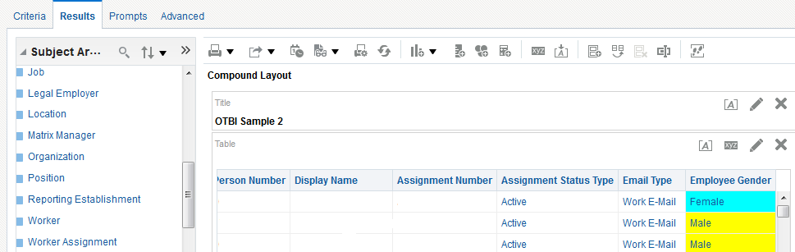
Build of Custom OTBI Report
Result of Analysis:

Slide 29
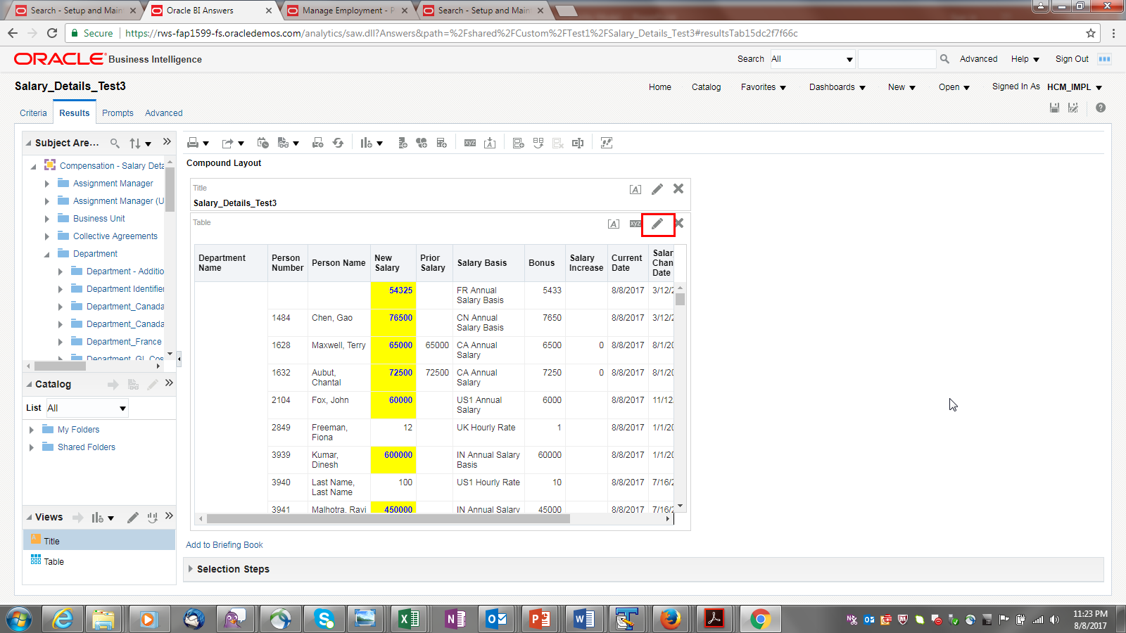
Build of Custom OTBI Report
Editing the View:

Slide 30
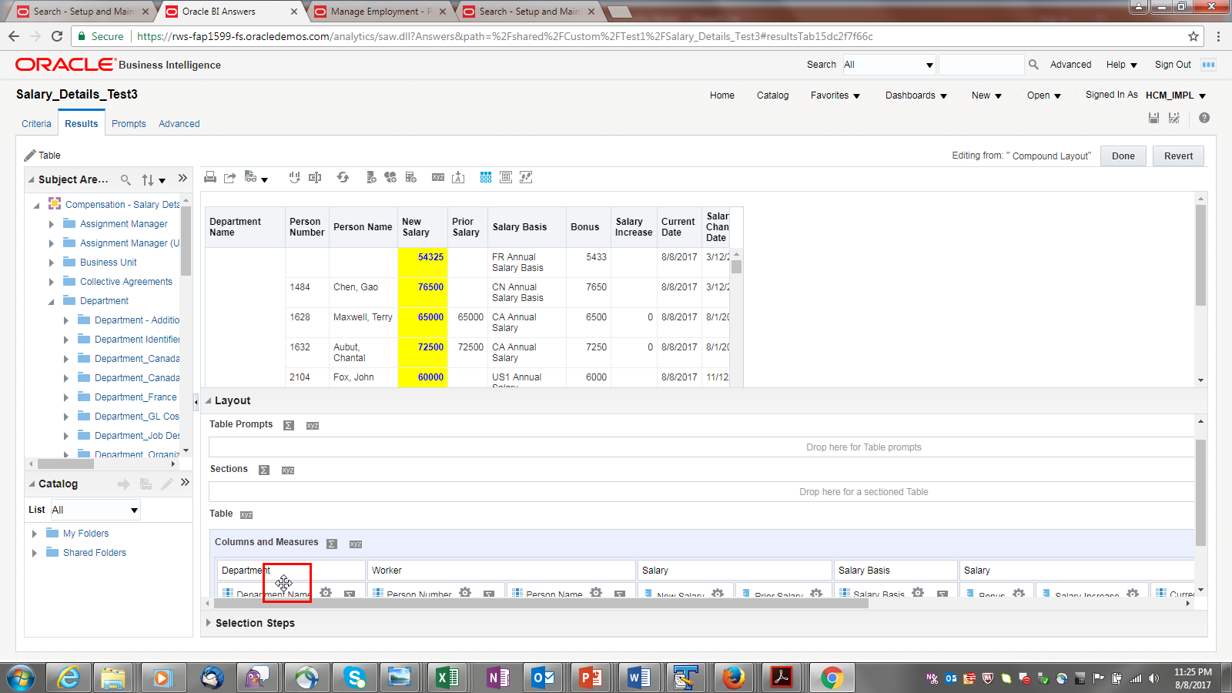
Build of Custom OTBI Report
Drag the “Department” column onto the “Table Prompts” area (use the crosshairs on the column to drag and drop the column to a different position).

Slide 31
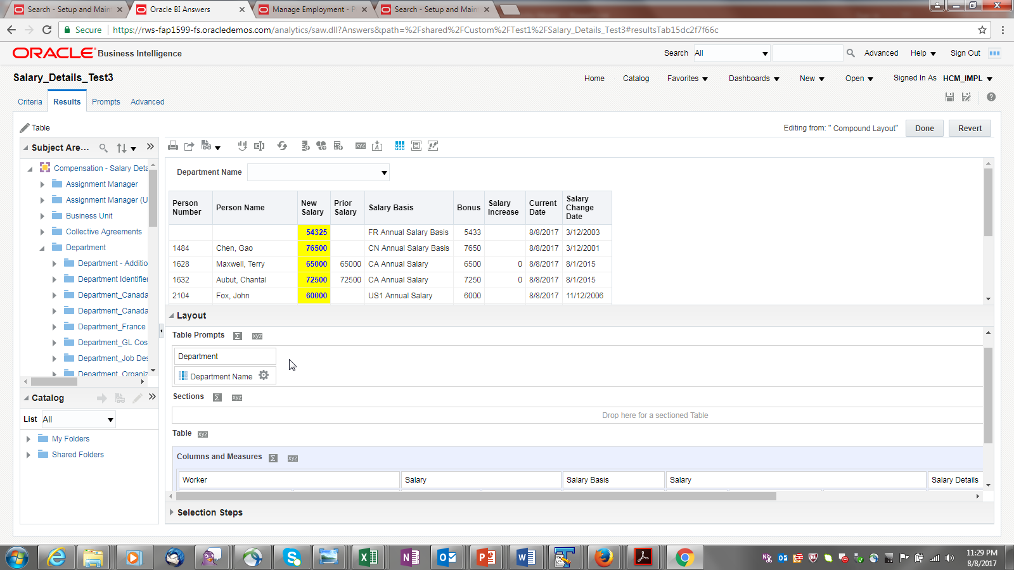
Build of Custom OTBI Report

Slide 32
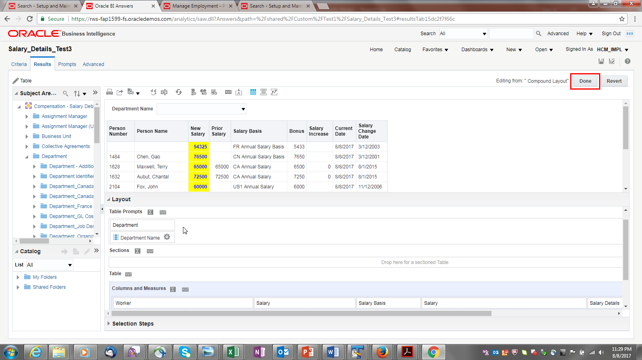
Build of Custom OTBI Report
Click on “Done” to close view editor.

Slide 33
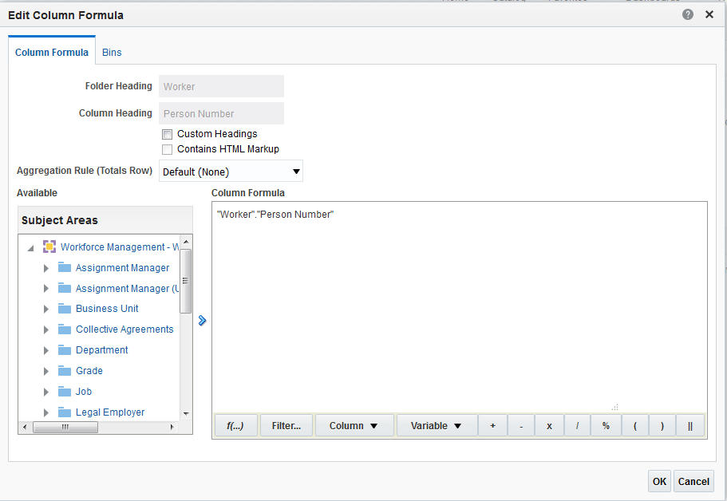
Creating OTBI Reports
Various Formula like Concatenate, Year, Month etc can be added to column.
Click Options beside the column name, select ‘Edit Formula’

Slide 34
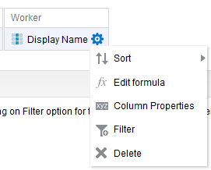
Creating OTBI Reports
To adding filter on column added, click Options beside the column name

Slide 35
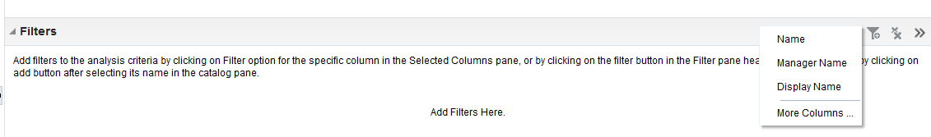
Creating OTBI Reports
To adding filter on column other than the columns added, click on “Add filter” icon in filters .
This will give option to add filter on selected columns or to pick columns from Subject area.

Slide 36
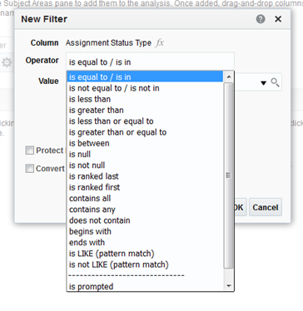
Creating OTBI Reports
In the New Filter dialog, select the appropriate operator such as is equal to / is in.

Slide 37
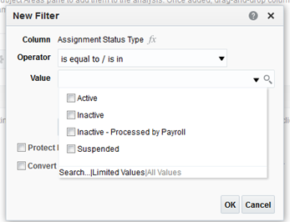
Creating OTBI Reports
Select values from the list or click the Search icon to find more values from which to select.

Slide 38
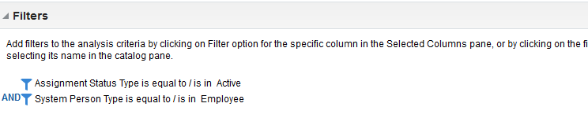
Creating OTBI Reports
Filter can be added on multiple columns and logical operator can be defined as “And” or “Or”

Slide 39
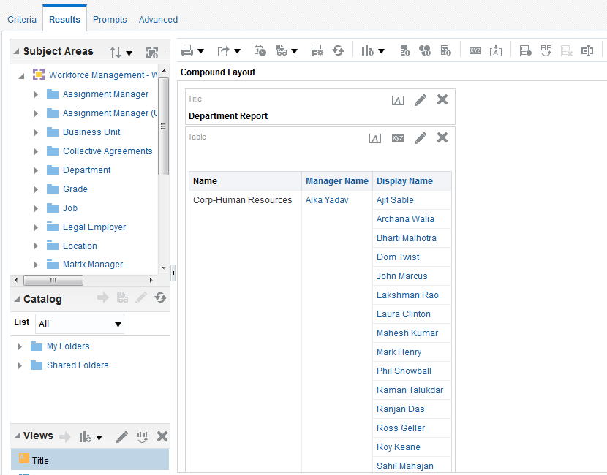
Creating OTBI Reports
To view the results, click on results tab. The analysis is displayed in the default Compound Layout, which includes a Title view and a Table view

Slide 40
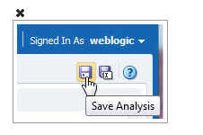
Creating OTBI Reports
To view the save the analysis, click the Save Analysis button to open the Save As dialog box.
To make the report accessible to other user, save it under “Shared folder”.

Slide 41
Cross Subject Area Reports

Slide 42
OTBI
Cross-Subject Area Reports
A report that combines data from more than one Subject Area. Such a query would be referred to as a Cross Subject Area query in this document.
Multiple subject areas are joined in report using conformed dimensions. The dimensions common to both subject areas are called as conformed dimensions.

Slide 43
Cross Subject Area
Report 1.
Cross Subject Area report on Worker Assignments and Assignment Events to fetch a count of Assignments, and # of hire and promotion events for a worker.
Subject area 1: Workforce Management - Worker Assignment Real Time
Subject area 2: Workforce Management – Worker Assignment Events Real Time
Common Dimension: Worker
Metrics (measures): Assignment Count comes from first subject area and # of Hires and Promotions from the second subject area.

Slide 44
Cross Subject Area
Query
SELECT
0 s_0,
"Workforce Management - Worker Assignment Real Time"."Worker"."Employee First Name" s_1,
"Workforce Management - Worker Assignment Real Time"."Worker"."Employee Last Name" s_2,
"Workforce Management - Worker Assignment Event Real Time"."Assignment Event"."# Of Hires" s_3,
"Workforce Management - Worker Assignment Event Real Time"."Assignment Event"."# Of Promotions" s_4,
"Workforce Management - Worker Assignment Real Time"."Worker Assignment"."Assignment Count" s_5
FROM "Workforce Management - Worker Assignment Real Time"
WHERE
(("Worker"."Employee First Name" = 'George') AND ("Worker"."Employee Last Name" = 'Weasley'))
ORDER BY 1, 2 ASC NULLS LAST, 3 ASC NULLS LAST
FETCH FIRST 65001 ROWS ONLY

Slide 45
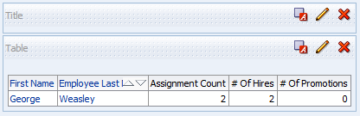
Cross Subject Area
Result

Slide 46
Cross Subject Area
Report 2.
Cross Subject Area query to fetch worker assignment and salary information.
Subject area 1: Workforce Management - Worker Assignment Real Time
Subject area 2: Workforce Compensation - Salary Details Real Time
Common Dimensions: Worker, Grade, and Location
Metrics:
“Worker Assignment Real Time” subject area: Headcount
“Salary Details Real Time” subject area: Current Salary, Annualized Salary, Previous Salary, Days Since Last Salary Change.

Slide 47
Cross Subject Area
Query
SELECT
0 s_0,
"Compensation - Salary Details Real Time"."HR Grade"."Grade Name" s_1,
"Compensation - Salary Details Real Time"."Worker Location"."Worker Location Name" s_2,
"Compensation - Salary Details Real Time"."Worker"."Employee Full Name" s_3,
"Workforce Management - Worker Assignment Real Time"."Location"."Location Address" s_4,
"Compensation - Salary Details Real Time"."Salary"."Annualized Salary" s_5,
"Compensation - Salary Details Real Time"."Salary"."Current Salary" s_6,
"Compensation - Salary Details Real Time"."Salary"."Days Since Last Salary Change" s_7,
"Compensation - Salary Details Real Time"."Salary"."Previous Salary" s_8,
"Workforce Management - Worker Assignment Real Time"."Worker Assignment"."Head Count" s_9
FROM "Compensation - Salary Details Real Time"
WHERE
("Salary"."Current Salary" IS NOT NULL)
ORDER BY 1, 4 ASC NULLS LAST, 2 ASC NULLS LAST, 3 ASC NULLS LAST, 5 ASC NULLS LAST
FETCH FIRST 65001 ROWS ONLY

Slide 48
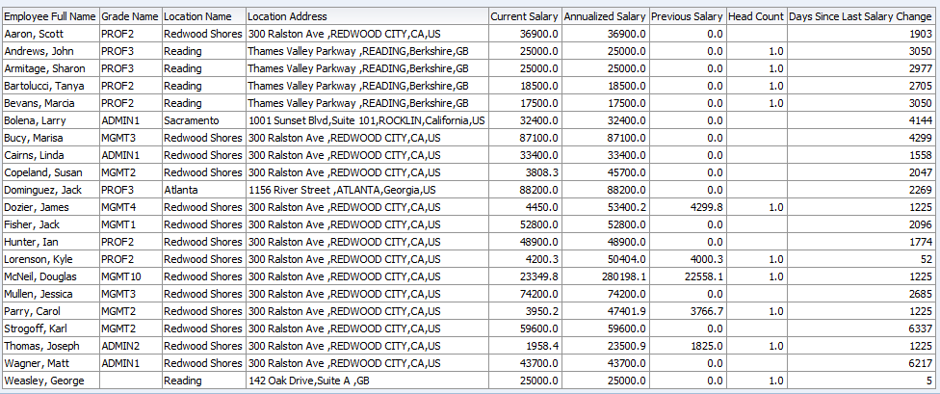
Cross Subject Area
Result

Slide 49
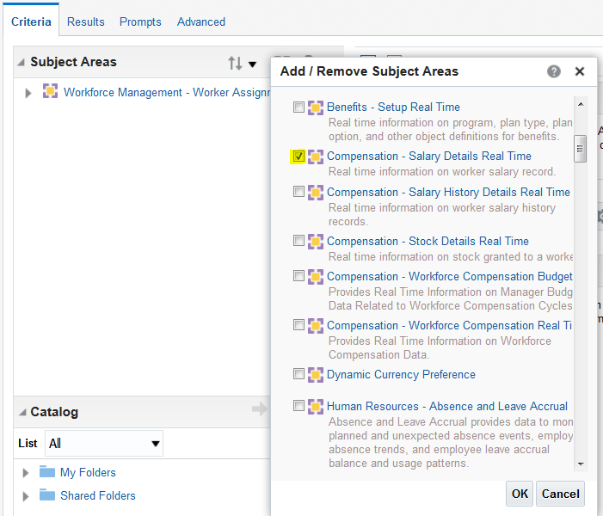
Cross-Subject Area Reports
Example

Slide 50
Accessing Flexfield

Slide 51
Accessing Flex fields
To use descriptive flex fields with Transactional Business Intelligence:
Define flex field segments.
Run the Import Oracle Fusion Data Extensions for Transactional Business Intelligence process.
Create an analysis in Transactional Business Intelligence.

Slide 52
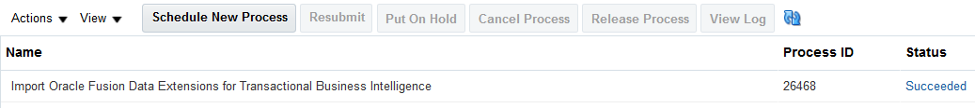
Accessing Flex fields
Once the flex fields have been deployed, the process can be run from
Navigation > Tools > Scheduled Processes
Click on “Schedule Process” button and search for “Import Oracle Fusion Data Extensions for Transactional Business Intelligence”

Slide 53
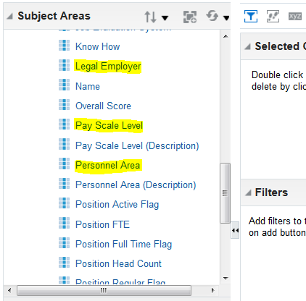
Accessing Flex fields
After you have successfully run the Import Oracle Fusion Data Extensions for Transactional Business Intelligence process, you can find and select the subject area that contains the flexfield that you deployed and imported.

Slide 54
Documentation

Slide 55
Historical Reporting with date as parameter
This document provides to create date parameter with calendar
This document gives subject areas which can support /not support historical reporting.

Slide 56
Adding Report on Home page
This document provides the steps to create a folder and add the report link on Home page through sandbox.

Slide 57
Documentation
OTBI Documentation
https://docs.oracle.com/en/cloud/saas/human-resources/20a/index.html
https://docs.oracle.com/en/cloud/saas/human-resources/20a/analyze-and-report.html
https://docs.oracle.com/en/cloud/saas/human-resources/20a/faohb/index.html

Slide 58
Q
&
A
58

